Slide 1







Capstone Project Stack Overflow Developer Survey 2019
Faquita Almas Fitriyadi
22 Apr 24

Slide 2



OUTLINE
Executive Summary
Introduction
Methodology
Results
Visualization – Charts
Dashboard
Discussion
Findings & Implications
Conclusion
Appendix

Slide 3

EXECUTIVE SUMMARY
Data Contextualization and analysis goal
Methodology description
Data Gathering
Data Analysis
Data Visualizations
Result presentation supported with graphs and trends
Discussion of findings, challenges and limitations
Conclusion

Slide 4

INTRODUCTION
Stack Overflow’s annual Developer Survey is the largest and most comprehensive survey of people who code around the world.
Random survey samples do not necessarily represent the developer communinty evenly but provide insights.
The presentation will help identify future skill requirements in the global IT sector necessary for the firm to keep pace with changing technologies and remain competitive.
Characterization of developers around the globe.
Recommendations will be stated based on the analysis.

Slide 5

METHODOLOGY
Collecting Data – Stack Overflow Developer Survey 2019
Data Wrangling
Exploratory data analysis
Finding Duplicates & Removing Duplicates.
Finding & Imputing Missing Value.
Normalizing Data.
Handling Outliners.
Correlation
Visualizaion Data
Visualization distribution, relation, composition & comparison of data
Dashboards

Slide 6
RESULTS

Slide 7
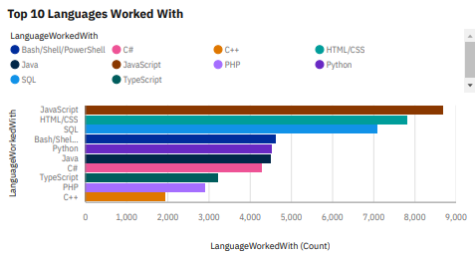
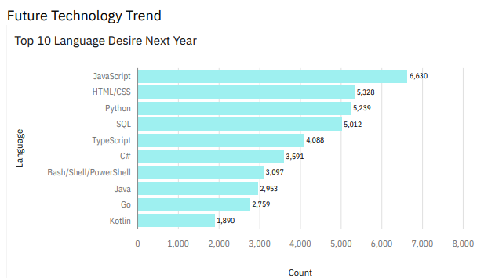
PROGRAMMING LANGUAGE TRENDS
Current Year
Next Year

Slide 8
PROGRAMMING LANGUAGE TRENDS - FINDINGS & IMPLICATIONS
Findings
JavaScript & HTML/CSS shows to be top dominant languages.
Javascipt, html/css, SQL will be the most use languanges next year and future years.
Python will have more demand then SQL next year.
Python & TypeScript are climbing the top 10 languages ladder.
Implications
Bash/Shell/PowerShell and Java are in decline.
JavaScript and HTML are used for web development as a tech skill has the highest demand especially Typescript is getting viral.
Python is gaining more and more traction due to the increasing demand for AI and ML skills.

Slide 9
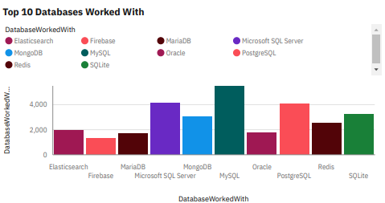
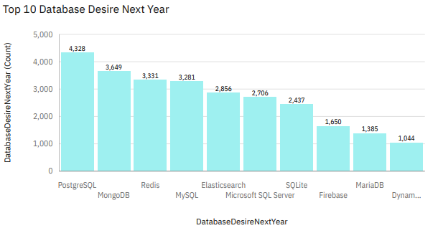
DATABASE TRENDS
Current Year
Next Year

Slide 10
DATABASE TRENDS - FINDINGS & IMPLICATIONS
Findings
PostgreSQL & MongoDB respectively are fast-growing
MySQL & Microsoft SQL Server popularity are expected to decline.
New Databases are gaining popularity and joining the race.
Implications
SQL is still a top told to watch out for in data specialist.
Companies still prefer open source databases.
Oracle SQL was not among the top 5. It’s losing relevance as time passes.
Firebase & Oracle are expected to be eliminated from top 10 databases.

Slide 11

DASHBOARD
<The GitHub link of the Cognos dashboard goes here.>

Slide 12
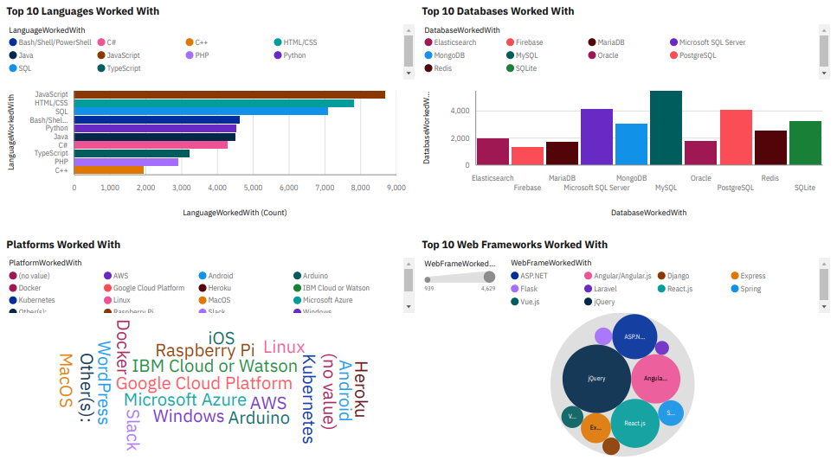
DASHBOARD TAB 1

Slide 13
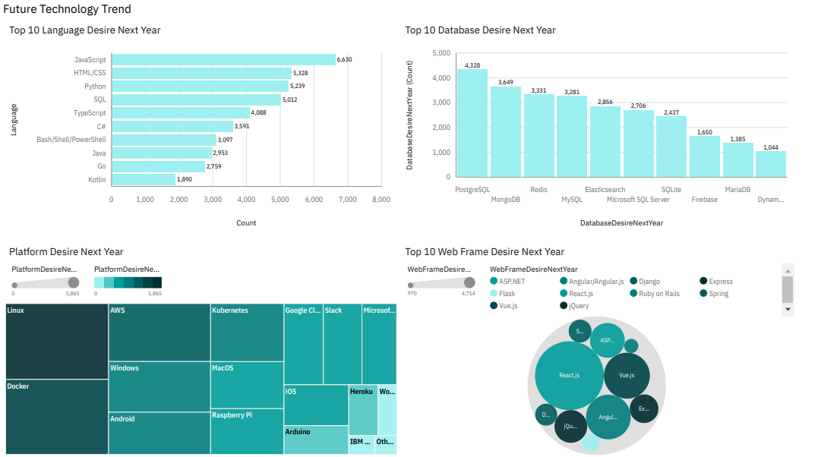
DASHBOARD TAB 2

Slide 14
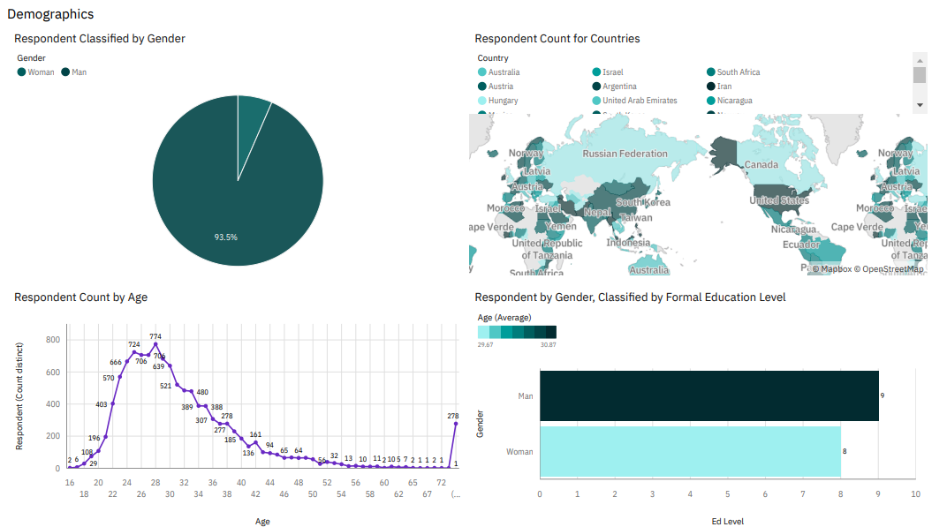
DASHBOARD TAB 3

Slide 15
DISCUSSION

Slide 16
OVERALL FINDINGS & IMPLICATIONS
Findings
Python & PostreSQL are fast growing as programming language and database.
Linux seems to remain dominant platform while React.js topped Webframes.
Strong youth presence in IT.
Pure skills contending with formal education might grow.
Implications
PowerShell & MySQL are in decline respectively.
Windows lagged behind for Docker as well as jQuery Webframe.
3.5 Male respondents predicts more male developers.
Majority of developers in developed countries

Slide 17

CONCLUSION
Change is the only constant in Tech world “survival to the most adaptive”.
Huge gender gap in IT needs further multivariate analysis.
Concentration of developers in developed countries insight investigating relation and correlation with immigration trends and governance issues in 3 rd world countries.
Youth leading IT inspire further studying of skills revolution over formal education.

Slide 18

APPENDIX

Slide 19
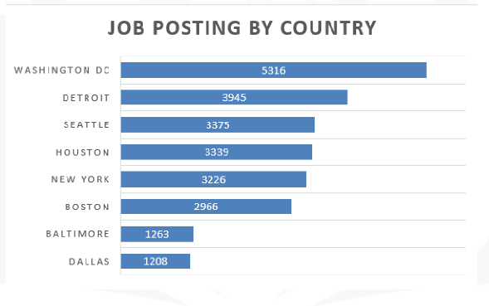
JOB POSTINGS

Slide 20
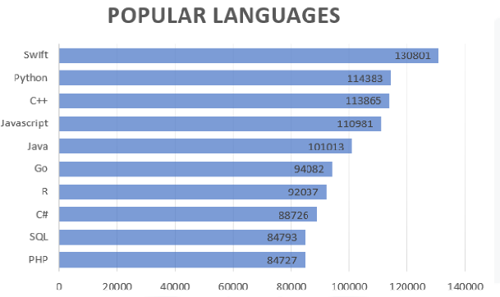
POPULAR LANGUAGES

